Slide 1

Regional License and Permits Program
Quarterly Meeting of the
Oversight Group Meeting
December 4, 2018

Slide 2
Oversight Agenda Item E
New Douglas County Oversight Member
  David Lundergreen

Slide 3

Oversight Agenda Item F
Silverflume State Business License update
  Interface went live on November 8, 2018 for the Citizen and backoffice side
  Secretary of State’s (SOS) recent request for a two way interface, discussions to resume in December 2018 and discuss a new agreement.
  No contingency funds were expended

Slide 4

Oversight Agenda Item G
Fiscal Manager’s November 29th Financial report
    Use of Credits and Contingency fund
    Contingency of $87,369.66 has not been used
    Credits from 2016 hosted reports: $3,524.56
    Credits anticipated from 2017-18 hosted reports totaling: (approx. 4-5 credits)
    Credits can be removed from total subscription cost before billing separate agencies
    Oversight direction on financials

Slide 5
Oversight Agenda Item H
FY 19-20 Accela Annual Subscription Fees Budget
  Last year’s Oversight Forecasted budget amount/not to exceed approved amount $460,000
    427 Accela Automation/ 159 Accela Mobile Licenses
  Actual: $408,670.32. Final license count invoiced:
    413 Accela Automation /122 Accela Mobile Licenses
  Forecasted 19/20 Subscription counts+3% increase:
    428 (+15)/133 Accela Mobile(+11) = $434,861.01
    3% maintenance increase $13,045.83 = $447,906.84
    Total forecasted budget: $480,000
  Payment expected by July 10, 2019 to Accela with 3% and increase in licenses

Slide 6
Oversight Agenda Item H (cont.,)
Approval of the $480,000 not to exceed Accela FY19/20 Subscription Amounts To include the 3% contractual increase in year 5 of subscription; with the following agency contributions: $48,000 for Douglas County, $72,000 for Health, $150,000 for City of Reno, $90,000 for City of Sparks, $120,000 for Washoe County- (For Possible Action)

Slide 7
Oversight Agenda Item I
Credit Card fees and methodology for the Citizen Access Platform
Currently the agencies are absorbing credit card fees since our go live Oct. 31, 2016
The citizen access platform has taken in $23.6 million in online payments.
  $19 million were by credit or debit card
  At 2.24% that is approx. $425,600 paid in credit card fees since go live.

Slide 8
Oversight Agenda Item I (cont.,)

Slide 9
Oversight Agenda Item I (cont.,)
Accela Online Payments by Department to date

Slide 10
Oversight Agenda Item I (cont.,)
  NRS 603A.215, NRS 354-760-790 allows for recouping of an agency’s credit card fees as long as the cost does not exceed the fees due to the processing companies.
  ACI/OPC is our vendor for epayments and the contract will expire Nov. 2019. Douglas County would like to pursue epayments on the ONE site, but cannot absorb the fees.
  (For Possible Action) Do we continue to absorb credit card fees or move to a citizen paid or partial citizen paid method? or
  Increase agency fees to cover the cost of credit card fees per NRS to not exceed what is charged in processing costs?

Slide 11
Oversight Agenda Item I (cont.,)
Based on research from ARC, and the epayments team, other agencies are not absorbing the fee (Clark County permits, Douglas County, Washoe Treasurer’s office, Courts.)
  Mixed model used at some agencies and departments
  Washoe Treasurer and Clark County, NV absorbs echeck fees (.15-.65 a transaction) ; citizen pays credit card fees
Any other additional information needed?

Slide 12
Item J: Updates from the Accela Regional Coordinating Team
Updates from the Accela Regional Coordinating team:
1. Accela Conference October 2018
2. Version 10.0 released 11/15/18; centered around performance enhancements
3. Douglas County addition to ACA (new images loaded)
4. Future roadmap and direction
  Douglas ACA and epayment implementation
  Epayment RFI
  Move ONE Project to Microsoft Azure cloud
  Silverflume 2 way interface
Notes:
Accela Onsite meeting Spring, new cloud Move, is coming discussions to start January, 2019

Slide 13
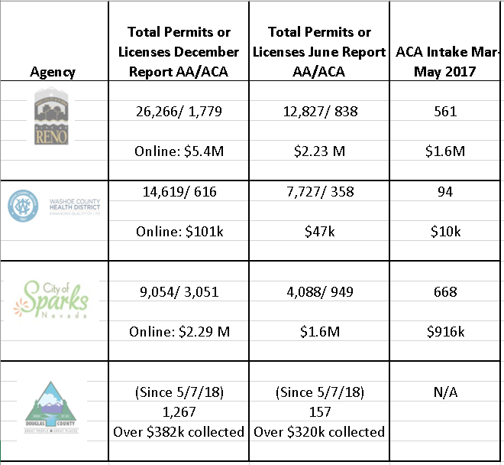
Item J: Updates from the Accela Regional Coordinating Team
(Cont.,)
5. Accela use and regional on-line payment statistics-
(June 1-Nov 2018)

Slide 14
Item K & L: Announcement/Reports/Updates & Future Agenda Items
Any Announcements/Reports/Updates?
Next Quarterly Meeting date of the Oversight Group
  Tues. March 5, 2019 - 2:30 pm Washoe County
  Future agenda items and ongoing meeting schedule

Slide 15

M. Public Comment
N. Adjournment

